Slide 1




網頁設計期末報告
Healthy Restaurant(Fatty Uncle)
01157061 吳俊威
01157160 陳天龍

Slide 2


1
Mission
Agenda
2
Web Structure
Topics Covered
3
Tehnology Used
4
Advantage of Website
5
Division of Labor

Slide 3
網站作品的創作動機
MOTIVATION FOR CREATING THE WEBSITE WORK

Slide 4
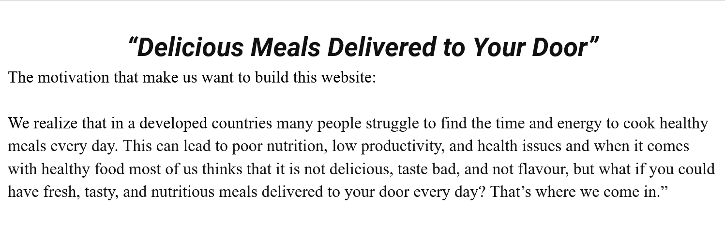

Slide 5
最後版本的網站架構(頁面結構)
The final version of the website architecture (page structure)

Slide 6
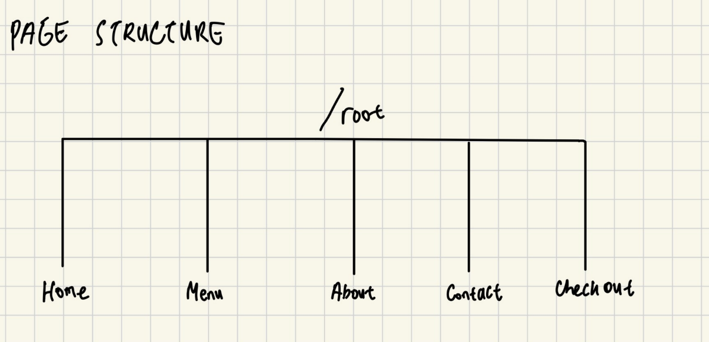

Slide 7
實際使用之WEB技術
WEB TECHNOLOGY USED IN THIS PROJECT

Slide 8
FRONT-END：
HTML
CSS
JAVASCRIPT
BACK-END:
NODE.JS
DATABASE:
MONGO DB

Slide 9
網站的特色與優點
FUNCTIONALITY AND ADVANTAGE OF WEBSITE

Slide 10
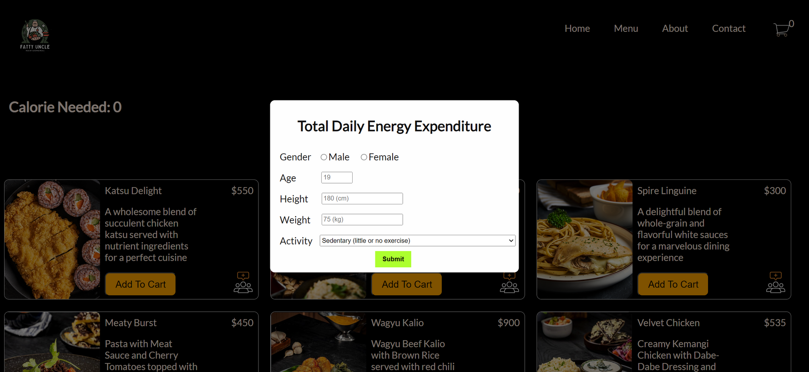
AFTER OPENING THE MENU PAGE, WE WILL PROMPT THE USER TO INPUT THE DATA NEEDED TO CALCULATE THE CALORIE FOR EACH DAY

Slide 11
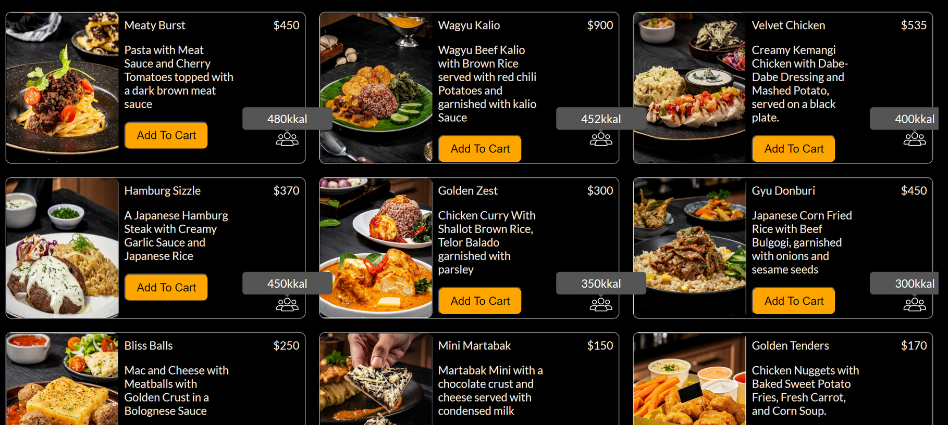
EACH FOOD WILL HAVE ITS OWN CALORIE

Slide 12
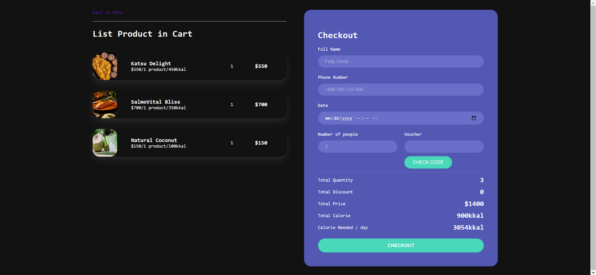
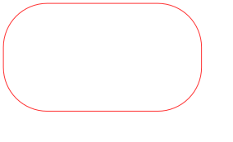
WE ALSO HAVE A ONE-TIME USE VOUCHER IN OUR CHECKOUT

Slide 13
最後實際的分工
DIVISION OF LABOR

Slide 14


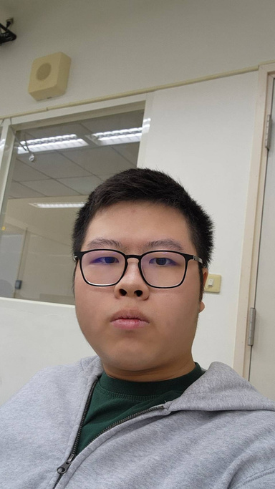
01157061 - 吳俊威:
01157060 - 陳天龍:
HTML
HTML
CSS
CSS
JAVASCRIPT
JAVASCRIPT
ASSETS
MONGODB
NODEJS
NODEJS
ABOUT AND CONTACT
INDEX ，MENU
AND CHECKOUT

Slide 15
GO TO OUR WEBSITE
https://geattt.github.io/Final-Project/

Slide 16
GO TO OUR GITHUB
https://github.com/Geattt/Final-Project.git

